Slide 1
Outline
II. Program Basics
H. Statements
6. Loops
Pretest: While
Posttest: Do-While
Pretest: For
Parts: termination condition, initialization, body
Pretest vs Posttest
Counter-controlled vs Event-controlled
Infinite Loops
Nested Loops

Slide 2
Repetitions with Loops

Slide 3
Types of Loops
Pretest - a logical condition is checked before each repetition to determine if the loop should terminate
while loop
for loop
Posttest - a logical condition is checked after each repetition for termination
do-while loop

Slide 4
PreTest vs. PostTest Loops

Slide 5
Terminating Loops
Counter-controlled loops - a loop controlled by a counter variable, generally where the number of times the loop will execute is known ahead of time
Event-controlled loops - loops where termination depends on an event rather than executing a fixed number of times

Slide 6
Counter-Controlled Loops
Generally with for loops
Can generally infer number of repetitions from code
Examples:
read 5 numbers
print 7 items
sort n items

Slide 7
Event-Controlled Loops
Generally with while, do-while loops
Can’t infer number of repetitions from program
Examples:
read until input ends
read until a number encountered
search through data until item found

Slide 8
Parts of Loop
Initialization - commands to set up loop (set counter to initial value, etc.)
Terminating condition - logical condition that is checked to terminate loop
Body of loop - commands repeated
action(s) - statements to repeat
update(s) - statements to update values associated with loop (counters, etc.)

Slide 9
Parts of Loop Example
Init: set counter to 0
Termination: counter < 5
Body:
Action: print *
Update: add 1 to counter

Slide 10
Importance of Update
What if command
counter++;
left out?
Counter never becomes >= 5.
Termination Condition never met.

Slide 11
Infinite Loops
Loop starts but termination condition never met:
you forget to increase counter
user never enters terminating data item
etc.
Results
program may stop (doing nothing repeatedly)
computer may repeatedly print some data out

Slide 12
Termination Conditions in C
Loops in C always continue when the termination condition is true and end when the condition is false
Conditions can be rephrased if needed (positive termination conditions can be negated)
Condition only checked at fixed points (does not have to hold true during body)

Slide 13
Pretest Loop: While
Syntax:
while (condition)
statement;
Corresponds to:
if (!condition) DONE
statement
if (!condition) DONE
statement
...

Slide 14
Example of While
int counter = 0;
while (counter < 5) {
printf(“*\n”);
counter++;
}
single statement is compound

Slide 15
Executing More Than One Stmt
In C, loops repeat one statement
Generally we always use a compound statement as that statement:
while (condition) {
/* body */
}
Useful even when body has one or no statements

Slide 16
Empty Statements and Loops
What’s wrong with this?
counter = 0;
while (counter < 5);
{
printf(“*\n”);
counter++;
}
Note the ; after the condition in the while, its an empty statement (which is the body of the while), so the while is an infinite loop

Slide 17
Event-Controlled While
While loops are often used to test for the occurrence of events that terminate loops
Example:
read in a set of numbers until a particular value is encountered
along the way count the set of numbers and the total of the numbers
print out the average of the numbers
does not terminate after a fixed point

Slide 18
Calculate Average Loop

Slide 19
Calculate Average Code
total = 0;
count = 0;
printf(“Please enter first number: “);
scanf(“%d”,&number);
while (number != -999) {
total += number;
count++;
printf(“Please enter next number: “);
scanf(“%d”,&number);
}
printf(“Average is %.3f\n”,(float) total / count);

Slide 20
Using a Sentinel
The value -999 is sometimes referred to as a sentinel value
The value serves as the “guardian” for the termination of the loop
Often a good idea to make the sentinel a constant:
#define STOPNUMBER -999
while (number != STOPNUMBER) ...

Slide 21
Compound Conditions
Often the termination condition is compound:
ans = ‘N’;
while (!((ans == ‘Y’) || (ans == ‘y’))) {
printf(“Enter id# and salary: “);
scanf(“%d %f”,&id,&salary);
printf(“You entered id#%1d and salary $%.2f, Is this correct? (Y/N) “,id,salary);
scanf(“ %c”,&ans);
}

Slide 22
Making Sure Loop is Entered
Note in previous loop, we had to set variable ans to an initial value, ‘N’
This is because a while loop tests its condition before entering the loop, and if the condition is already false, the loop never executes
Sometimes it is useful to have a loop that always executes at least once

Slide 23
Posttest Loop: Do-While
Syntax:
do {
statement(s)
} while (condition);
Corresponds to:
statement
if (!condition) DONE
statement
if (!condition) DONE
...

Slide 24
Using the Do-While
do {
printf(“Enter id# and salary: “);
scanf(“%d %f”,&id,&salary);
printf(“You entered id#%1d and salary $%.2f, Is this correct? (Y/N) “ ,id,salary);
scanf(“ %c”,&ans);
} while (!((ans == ‘Y’) || (ans == ‘y’)));
Loop always executes at least once

Slide 25
While vs Do-While
Differences
where condition tested:
while (first) - may execute 0 times
do-while (last) - must execute at least one time
Similarities
initialization before loop
update during loop

Slide 26
Pretest Loop: For
Initialization included in loop header
Update included in loop header
Header also includes update
Syntax:
for ( init ; condition ; update )
statement;
Generally for loops expected to execute fixed number of times (counter-controlled)

Slide 27
For Loop
Syntax:
for ( init ;
condition ;
update )
statement;
Init: assignments to counter variables
Update: changes to counter variables

Slide 28
For Example
Printing vertical line of stars:
for (counter = 0;
counter < 5;
counter++)
printf(“*\n”);

Slide 29
For Example - Sum of 1 to N
printf(“Number to sum to: “);
scanf(“%d”,&N);
total = 0;
for (I = 1; I <= N; I++)
total += I;
/* total is now 1 + 2 + … + N */

Slide 30
For Example - Max of N Scores
printf(“Number of students: “);
scanf(“%d”,&NumStudents);
for (I = 0; I < NumStudents; I++) {
printf(“Enter student score %d: “);
scanf(“%d”,&score);
if (score > max)
max = score;
}
/* max is highest score entered */

Slide 31
The Comma Form
Possible to evaluate more than one expression (assignment) in initialization or update by separating each by commas
Syntax: expression , expression , …
printf(“Number to sum to: “);
scanf(“%d”,&N);
for (total = 0, I = 1;
I <= N;
total += I, I++);
/* total is now 1 + 2 + … + N */

Slide 32
break statement
The break statement ends the loop immediately when it is encountered. Its syntax is:
break;
The break statement is almost always used with if...else statement inside the loop.

Slide 33
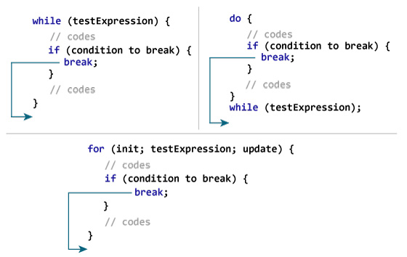
break statement

Slide 34
BREAK EXAMPLE
// Program to calculate the sum of numbers (10 numbers max)
// If the user enters a negative number, the loop terminates
#include <stdio.h>
int main() {
int i;
double number, sum = 0.0;
for (i = 1; i <= 10; ++i) {
printf("Enter a n%d: ", i);
scanf("%lf", &number);
// if the user enters a negative number, break the loop
if (number < 0.0) {
break;
}
sum += number; // sum = sum + number;
}
printf("Sum = %.2lf", sum);
return 0;
}

Slide 35
continue statement
The continue statement skips the current iteration of the loop and continues with the next iteration. Its syntax is:
continue;
The continue statement is almost always used with the if...else statement.

Slide 36
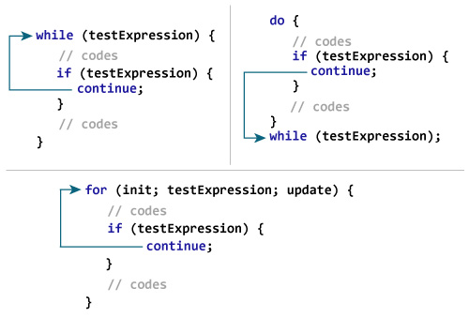
continue statement

Slide 37
Avoiding continue
Can generally use an if to avoid a continue:
for (I = 0; I < 100; I++) {
if ((I % 2) == 1) continue;
printf(“%d is even”,I);
}
becomes
for (I = 0; I < 100; I++) {
if (!((I % 2) == 1))
printf(“%d is even”,I);
}

Slide 38
CONTINUE EXAMPLE
// Program to calculate the sum of numbers (10 numbers max)
// If the user enters a negative number, it's not added to the result
#include <stdio.h>
int main() {
int i;
double number, sum = 0.0;
for (i = 1; i <= 10; ++i) {
printf("Enter a n%d: ", i);
scanf("%lf", &number);
if (number < 0.0) {
continue;
}
sum += number; // sum = sum + number;
}
printf("Sum = %.2lf", sum);
return 0;
}

Slide 39
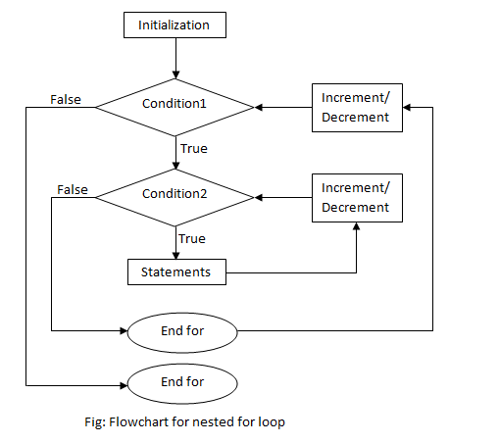
Nested for loop

Slide 40
Nested for Loop
for(i=1; i<=10; i++) {
for(j=1;j<=10; j++) {
printf(“%d %d\t”,i,j);
}
printf(“\n”);
}

